Slide 1
Royal Crown
E-Commerce Platform for Luxury Watches
Sagil Kureshi | BCA Semester 5
Guide: Prof. Nilesh Parghi
Kamani Science College & Prataprai Arts College, Amreli

Slide 2

Introduction
Royal Crown is a premium online e-commerce platform designed exclusively for luxury watch enthusiasts — bringing the finest timepieces to discerning customers through a seamless digital experience.
🛍️ Browse & Buy
🔐 Secure Access
Customers can explore, search, and purchase premium watches from top global brands with ease.
Dedicated user registration and login system ensures a safe and personalized shopping experience.
⚙️ Admin Control
Administrators can manage the full product catalog and monitor all customer orders from a central dashboard.

Slide 3
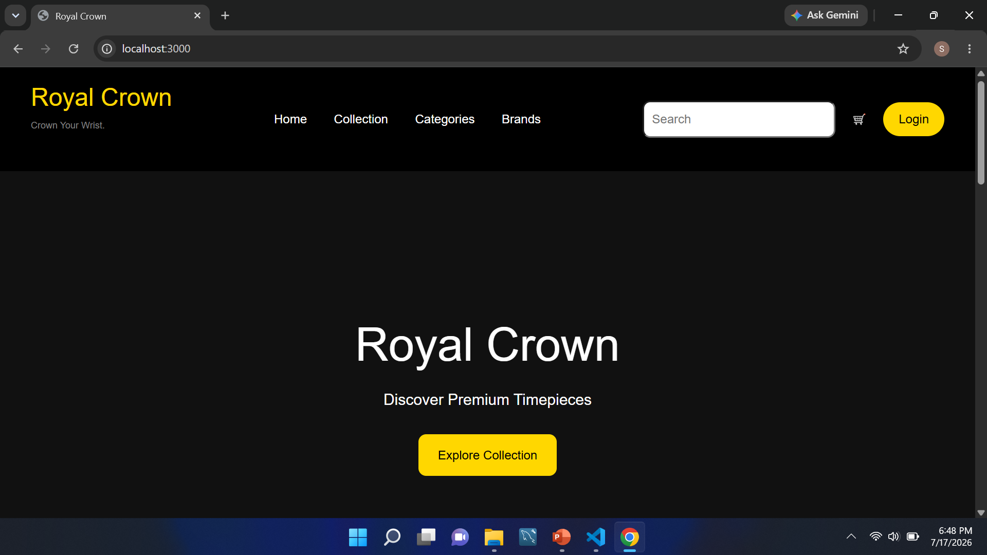





User Module
Registration
Login
Create a new account to access the platform.
Secure authentication for returning customers.
Browse & Product Details
Shopping Cart
Explore the full catalog with detailed watch pages.
Add items and manage selections before checkout.
Place Orders
Complete purchases securely and track orders.

Slide 4
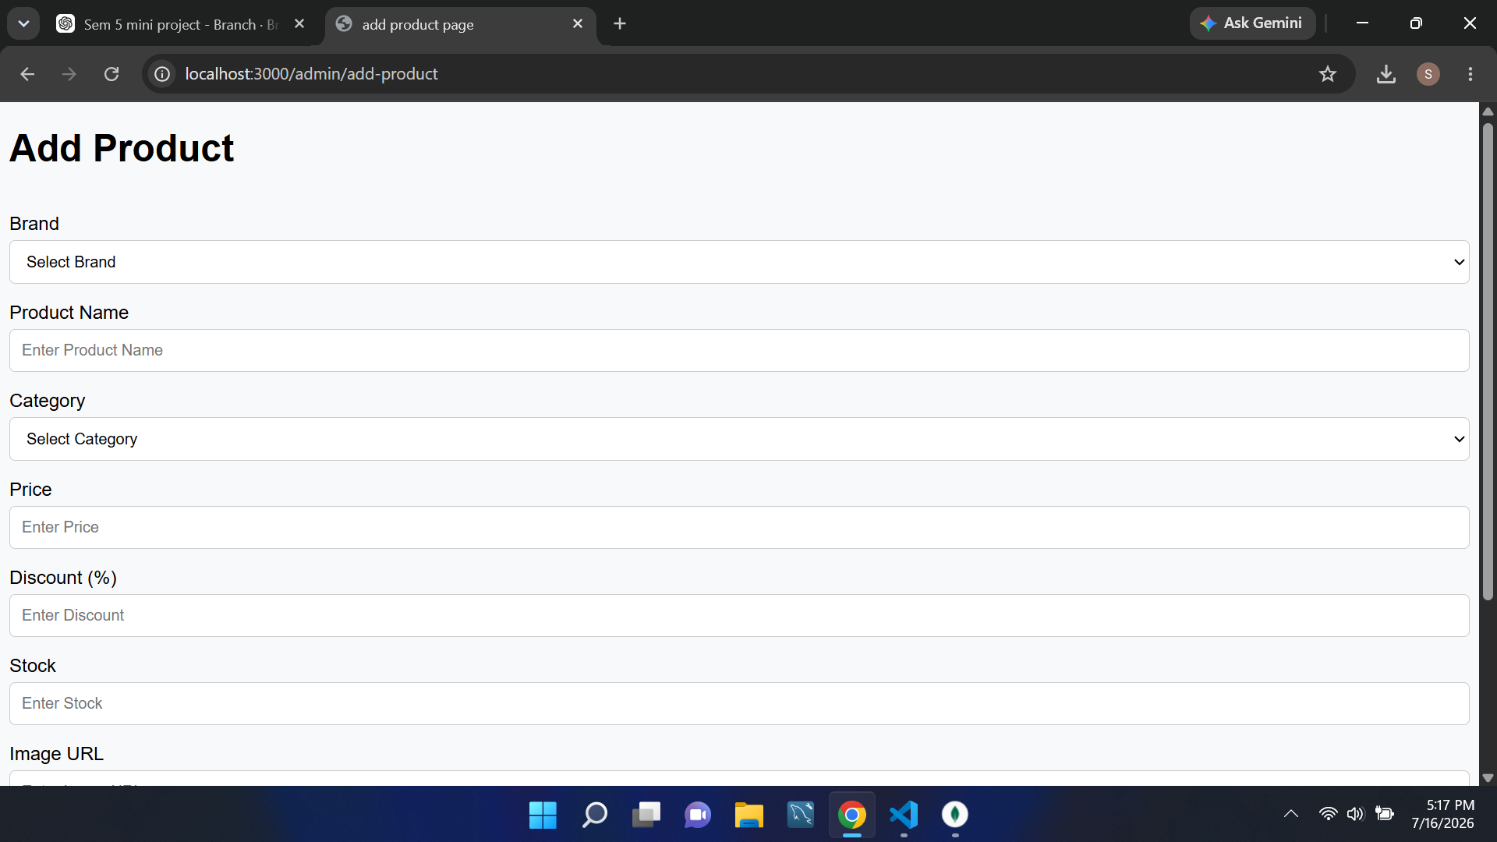





Admin Module
Admin Login
Dashboard
Secure admin-only authentication portal.
Overview of sales, products, and orders at a glance.
Add Product
Manage Products & Orders
Upload new watches with images, price, and details.
Edit, delete, and update listings; track all orders.
Logout
Secure session termination for admin safety.

Slide 5








Watch Collection
PREMIUM BRANDS
Rolex
Omega
Patek Philippe
TAG Heuer
Longines
Tissot
Rado
Seiko

Slide 6







Watch Categories
Luxury Watches
Classic Watches
Sports Watches
Chronograph Watches
Limited Edition

Slide 7
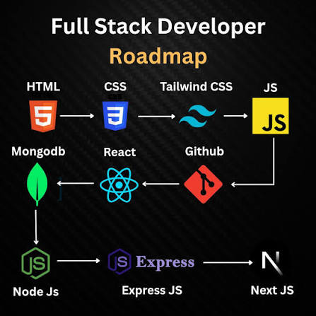











Technology Stack
HTML5
CSS3
JavaScript
Markup
Styling
Interactivity
Bootstrap
Node.js
Express.js
Responsive UI
Runtime
Framework
EJS
MongoDB Atlas
VS Code
Templating
NoSQL Cloud
Editor
Git & GitHub
MongoDB Compass
Version Control
GUI Tool

Slide 8
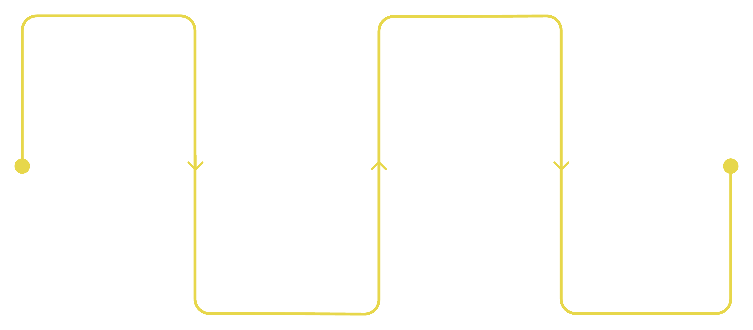
System Architecture
End-to-end flow from user interaction to data storage — a clean, layered MVC-inspired architecture powering Royal Crown.
User / Admin
Backend
Interact via UI and admin panel
Node.js, Express.js, EJS templating
Frontend
Database
HTML5, CSS3, Bootstrap, JavaScript
MongoDB Atlas for storage
Frontend, backend, and database layers work sequentially to render views, process requests, and store data in MongoDB Atlas.

Slide 9






Advantages
Easy Online Shopping
Secure Login
Browse and buy with ease.
Accounts stay protected.
Responsive Website
Premium Watch Collection
Works on every device.
Explore 8 luxury brands.
Fast Product Management
Easy Navigation
Update products instantly.
Find watches quickly.

Slide 10
Thank You
Sagil Kureshi | BCA Semester 5
Royal Crown — E-Commerce Platform for Luxury Watches
Guide: Prof. Nilesh Parghi
Kamani Science College & Prataprai Arts College, Amreli

